Slide 1


Media Engineering and Technology Faculty
German University in Cairo
Capstone Project
Process mining of
Traffic fines management system
Presented By:
Ola Amin
Mohamed Mahmoud
Ahmed Abd El-Atti
Supervised By:
Dr. Mervat Abuelkheir
Date: 08 AUG 2022

Slide 2
Motivation
Process Mining can be viewed as an alliance between data science and process management. This association supports stronger relationships between IT and business teams since it is expected to use data – also referred as events – from the IT systems to improve the operational processes.
IT systems provide the true and concrete sources of information for business processes, and the business teams leverage the log of events to improve their products and the customer experience. In parallel, employers experience is also enhanced as they are provided with information that represents the real processes instead of models that may be inaccurate.

Slide 3
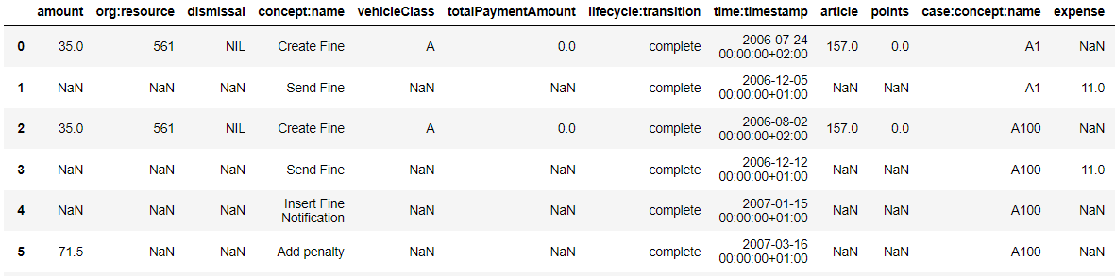
Data
The event log of a “Road traffic fine management” process (managing fines punishing road traffic infractions, i.e., speeding) contains real data of an Italian regional agency for traffic management.

Slide 4
Questions or problems
The stories in a snapshot
What are the journeys of an offender through the bureaucracy of the road traffic management system?
What stands out in terms of waiting times? What could be considered atypical behaviour?
What stands out in terms of repetitive behaviour?
Dig into the stories
What is typical behavior for each category of interest?
Any particular behavioral difference (in time / successions of steps) between offenders who (eventually) pay their fines and those who don’t?
Optimization checkpoints
What is the story behind unwanted performance indicator values (e.g. outstandingly long end-to-end waiting times | loops | successions of steps)? Is there anything that could be done to decrease them?
Are there unnecessary repetitive steps that contribute to increasing delays in the system?

Slide 5
Data processing
Configuration of information for a process mining analysis

Slide 6
Reshape the Dataset
Data should have the basic configuration for process analysis which includes { Case ID , Event , Timestamp}
Columns that may be used for filtering purposes: ‘Amount’, ‘article’,‘points’, ‘org:resource’, ‘vehicleClass’, ‘totalPaymentAmount’, ‘notificationType’, ‘expense’.
New columns “Dates , Year , Month” have been added to the data to ease the filtering process
NAN values for the same case ID have been replaced with the same values in “Points , Vehicle Class “
NAN values for events that don’t require payment have been replaced with 0 .

Slide 7
Reshape the Dataset
Data should have the basic configuration for process analysis which includes { Case ID , Event , Timestamp}
Columns that may be used for filtering purposes: ‘Amount’, ‘article’,‘points’, ‘org:resource’, ‘vehicleClass’, ‘totalPaymentAmount’, ‘notificationType’, ‘expense’.
New columns “Dates , Year , Month” have been added to the data to ease the filtering process
NAN values for the same case ID have been replaced with the same values in “Points , Vehicle Class “
NAN values for events that don’t require payment have been replaced with 0 .

Slide 8
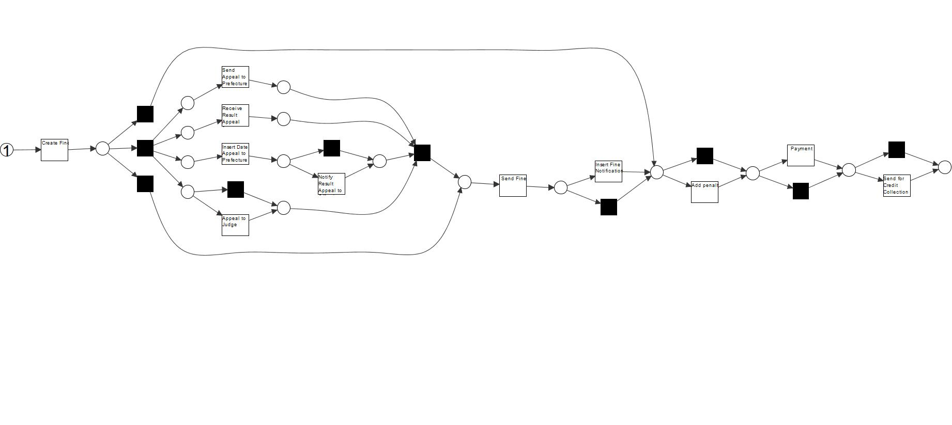
Process discovery using inductive miner
Process flow can be visualized using any type of miner ex: Alpha miner , Inductive or Directly-Follows Graph

Slide 9
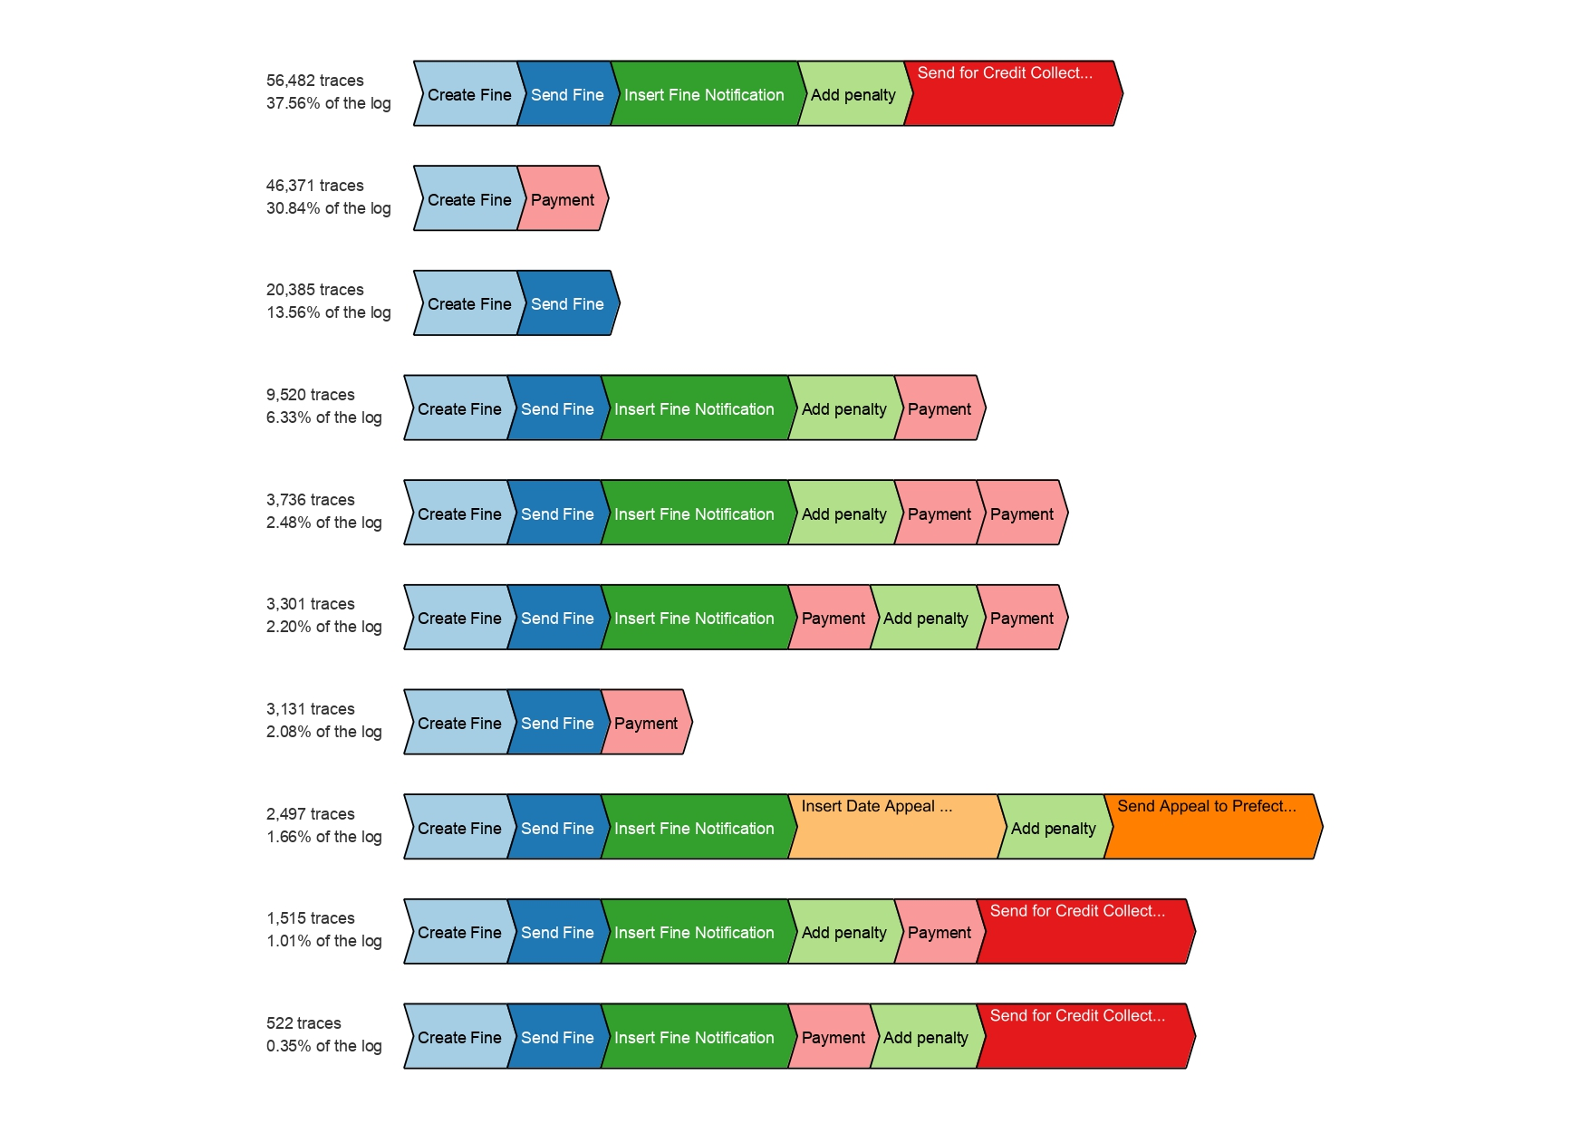
Trace variants visualisation
This step was achieved using both ProM mining tool and PM4PY K variant filtering in the code

Slide 10
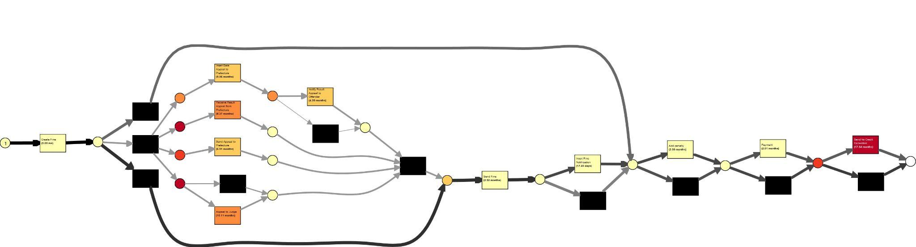
Define Bottleneck of process
we found the average wait time for credit collection is 17.54 months.Same goes for “recieving the result for appealing” with average wait time of 8.37 months and “appeal to judge with average wait time of 10.11 months Model performance analysis using ProM

Slide 11
Optimization checkpoints
Officially decrease the unnecessarily long waiting time (of approx. 2 years) before transferring an issue to a third party.
Digital transformation: to ensure that once payments are made, updates are automatically sent to the other subsystems.
Payment is unexpectedly executed twice, most probably because people omit to pay the penalty received the first time. This issue could be easily tackled by not allowing payments that do not match the total amount of the fine, and displaying a message to inform on the spot about the reason for payment denial.
Make the appeal process only possible after the payment is complete it will speed up the process yet save the client’s right to dispute fines .

Slide 12
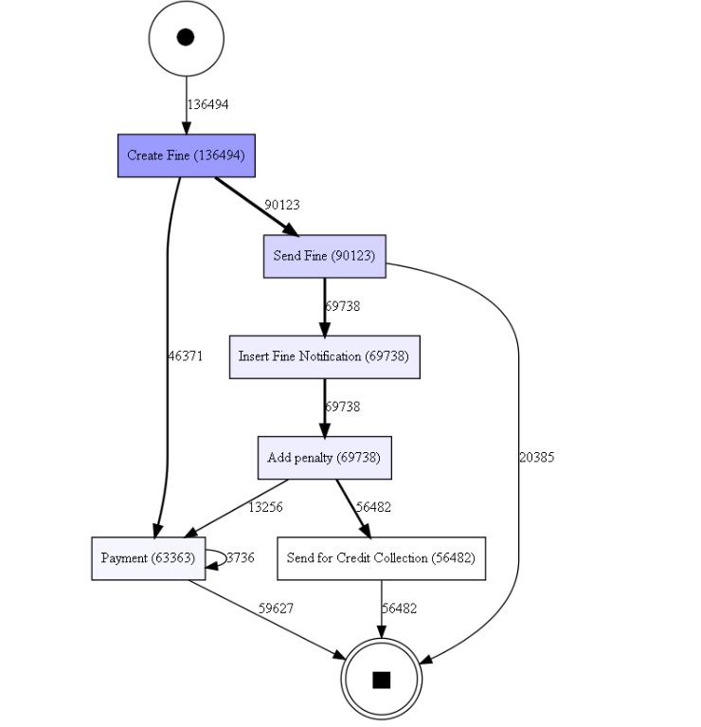
Result
Figure shows the visualization of improved process using the DFG miner
IT shows less noise in the process flow
For future improvement we can increase the notification methods to include phone calls , text message or official letters to the offender .
Increase the payment channels to include direct deposit , bank transfer , mobile wallet transfer or check

Slide 13
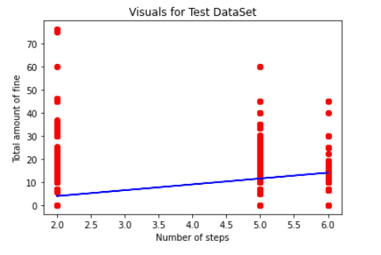
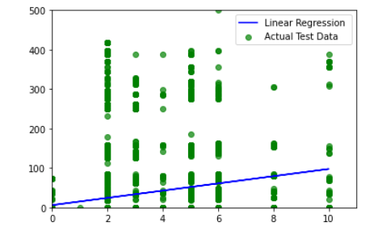
Algorithm
For prediction as the data is continuous we used linear regression to predict the amount of fine based on the number of points on the record .
Also we used linear regression algorithm to predict the amount of expenses based on the number of steps per process .

Slide 14
Thank you

